Slide 1
GRAFAI. ĮVADAS Doc. E.Mačikėnas

Slide 2
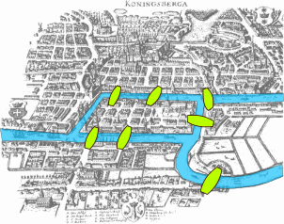
GRAFAI. ĮVADAS
One of the first results in graph theory appeared in Leonhard Euler's paper on Seven Bridges of Königsberg, published in 1736.
The Seven Bridges of Königsberg is a famous solved mathematics problem inspired by an actual place and situation. The city of Königsberg, Prussia (now Kaliningrad, Russia) is set on the Pregel River, and included two large islands which were connected to each other and the mainland by seven bridges. The question is whether it is possible to walk with a route that crosses each bridge exactly once, and return to the starting point. In 1736, Leonhard Euler proved that it was not possible.

Slide 3
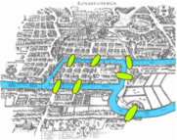
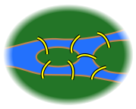
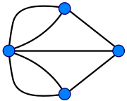
GRAFAI. ĮVADAS
The resulting mathematical structure is called a graph.
→
In the history of mathematics, Euler's solution of the Königsberg bridge problem is considered to be the first theorem of graph theory.

Slide 4
GRAFAI. ĮVADAS
In 1845 Gustav Kirchhoff published his Kirchhoff's circuit laws for calculating the voltage and current in electric circuits.
In 1852 Francis Guthrie posed the four color problem which asks if it is possible to color, using only four colors, any map of countries in such a way as to prevent two bordering countries from having the same color. This problem, which was only solved a century later in 1976 by Kenneth Appel and Wolfgang Haken.
In 2004 Benjamin Werner and Georges Gonthier formalized a proof of the theorem inside the Coq proof assistant (Gonthier, n.d.). This removes the need to trust the various computer programs used to verify particular cases — it is only necessary to trust the Coq proof assistant.

Slide 5
GRAFAI. ĮVADAS
Taikymų pavyzdžiai:
Transportation networks How should you design the highway network in a country? What is the quickest way to drive from Badda to Naraynganj?
Communication networks How to send a network packet from Bracu intranet to Yahoo mail server?
Information networks Is the World wide a directed or undirected network?
Social networks Facebook, Myspace, Flickr, ...
Dependency networks What courses must you take before you can take CSE-423?
Mazes Is there way out of a maze? If so, what is a path from entrance to exit?

Slide 6
GRAFAI. ĮVADAS
Naudingos nuorodos:
www.cse.msstate.edu/~cse2813/2813Ch9.ppt
http://moodle.bracu.ac.bd/mod/page/view.php?id=526
http://roticv.rantx.com/book/IntroductiontoGraphs.pdf
http://graal.ens-lyon.fr/~bucar/CR07/lecture-graphs.pdf

Slide 7
GRAFAI. ĮVADAS
Pabaiga

